Slide 1

Graphical Models
Module 4 Live Session (6/15/2021)
DS6040 Summer 2021
Teague R. Henry

Slide 2

Course Updates
Homework 1 Due Friday by 11:59pm
Problem 2 will be given full credit
Problem 7 is now extra credit
Project Proposal Also Due Friday
Turn in 1 per team, I’ll concatenate and mark for credit
Homework 2 now available
Classifying wine quality!
Various resources uploaded to Collab

Slide 3
Outline
Review
What is a Model?
Directed Acyclic Graphs and Plate Diagrams
PyMC3 – Programming with Probability

Slide 4
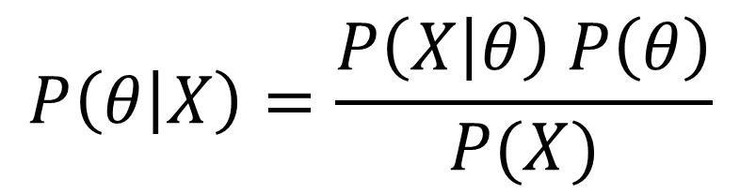
Review
Likelihood
Posterior Distribution
$$P\left(θ | X\right)=\frac{P\left(X | θ\right) P\left(θ\right)}{P(X)}$$
Prior Distribution
Marginal Distribution

Slide 5
Review
We know the ingredients to a Bayesian “recipe”
Data – Always got to have your data
Model – How are you planning on representing that data?
Prior – What do you think about your model before you add data?
From these elements, we get the posterior and its characteristics
Posterior – Distribution of parameters (i.e. model) given data
EAP – Expected A Posteriori Value
MAP – Modal A Posteriori Value
Credible Intervals
Until now, the models have been either simple (i.e. a binomial) or given to you (i.e. linear regression)…

Slide 6
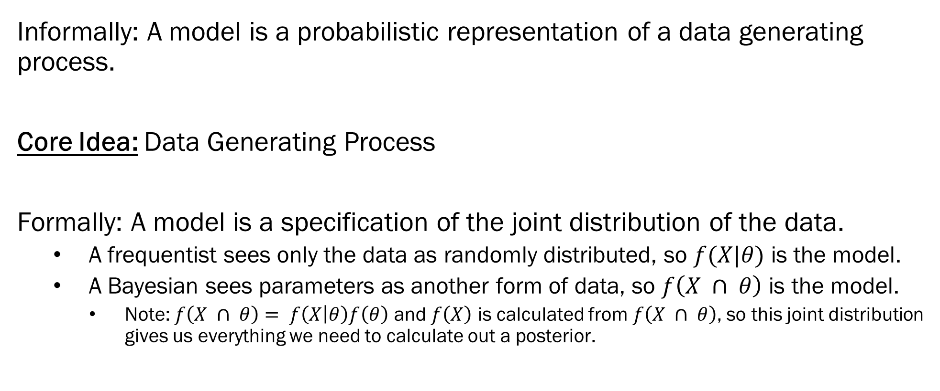
What is a Model?
Informally: A model is a probabilistic representation of a data generating process.
Core Idea: Data Generating Process
Formally: A model is a specification of the joint distribution of the data.
A frequentist sees only the data as randomly distributed, so $f(X|θ)$ is the model.
A Bayesian sees parameters as another form of data, so $f\left(X ∩ θ\right)$ is the model.
Note: $f\left(X ∩ θ\right)= f\left(X | θ\right)f\left(θ\right)$ and $f\left(X\right)$ is calculated from $f\left(X ∩ θ\right)$, so this joint distribution gives us everything we need to calculate out a posterior.

Slide 7
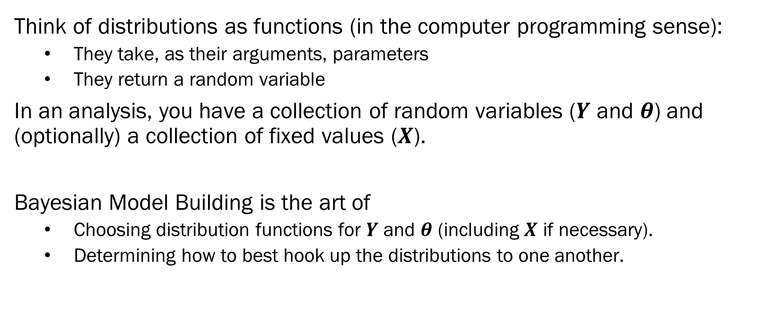
pip install pydot-ng
Bayesian Model Building
Think of distributions as functions (in the computer programming sense):
They take, as their arguments, parameters
They return a random variable
In an analysis, you have a collection of random variables ($Y$ and $θ$) and (optionally) a collection of fixed values ($X$).
Bayesian Model Building is the art of
Choosing distribution functions for $Y$ and $θ$ (including $X$ if necessary).
Determining how to best hook up the distributions to one another.

Slide 8
pip install pydot-ng
Bayesian Model Building
What is possible with Bayesian modelling?
Anything
(almost)
Three restrictions –
Model must make mathematical sense (Obvious requirement)
E.g: You can’t specify a multivariate prior for a uni-dimensional parameter
E.g: Variances are positive…
Model must be identifiable
Quick version: information flows in one direction, no tautological definitions
Model must be computationally tractable
Very much context dependent
Reparameterizations can often make intractable models tractable.

Slide 9

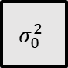
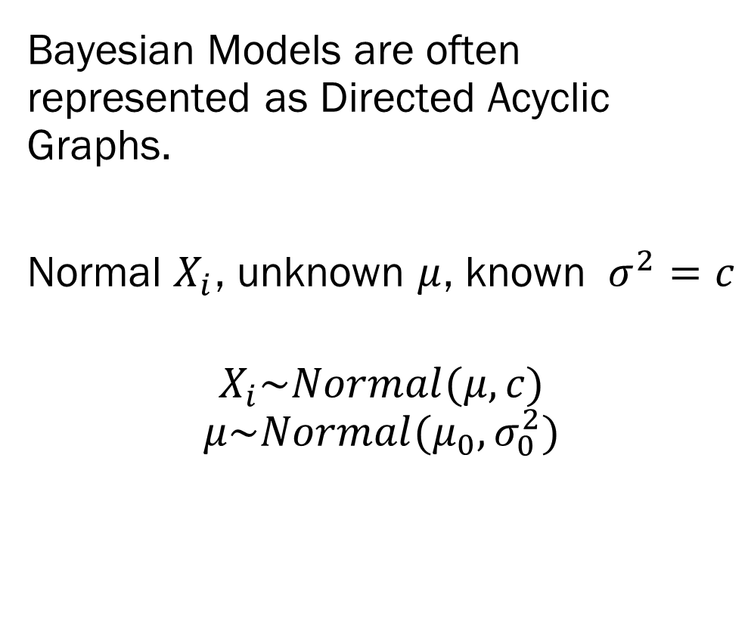
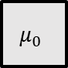
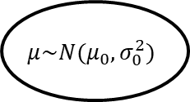
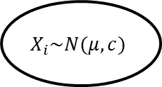
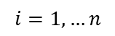
pip install pydot-ng
Graph Representations
Bayesian Models are often represented as Directed Acyclic Graphs.
Normal $X_{i}$, unknown $μ$, known $σ^{2}=c$
$$X_{i}\sim Normal(μ, c)$$
$$μ\sim Normal(μ_{0}, σ_{0}^{2})$$
$$μ_{0}$$
$$σ_{0}^{2}$$
$$μ\sim N(μ_{0}, σ_{0}^{2})$$
$$c$$
$$X_{i}\sim N(μ, c)$$
$$i=1, …n$$

Slide 10
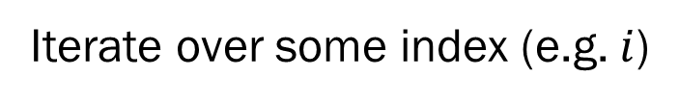
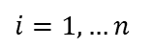
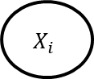
pip install pydot-ng
Graph Representations
Hyperparameter Values
$$μ_{0}$$
$$σ_{0}^{2}$$
Random Variables
$$μ\sim N(μ_{0}, σ_{0}^{2})$$
$$c$$
Constants
$$X_{i}\sim N(μ, c)$$
A
B
B is dependent on A
$$i=1, …n$$
$$X_{i}$$
Iterate over some index (e.g. $i$)
$i=1, …n$

Slide 11
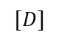
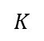
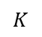
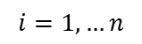
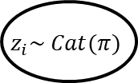
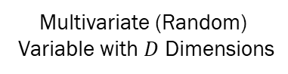
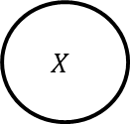
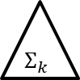
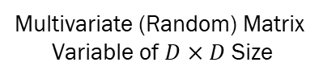
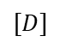
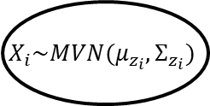
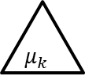
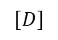
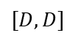
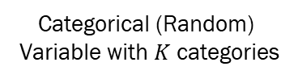
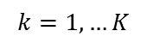
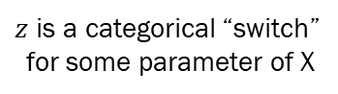
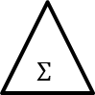
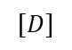
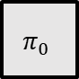
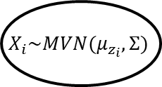

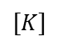
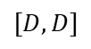
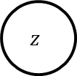
pip install pydot-ng
Graph Representations
Linear Discriminant Analysis
Quadratic Discriminant Analysis
$$k=1, …K$$
$$k=1, …K$$
$$μ_{k}$$
$$Σ$$
$$μ_{k}$$
$$Σ_{k}$$
$$[D]$$
$$[D,D]$$
$$[D]$$
$$[D,D]$$
$$π_{0}$$
$$z_{i}\sim Cat(π)$$
$$X_{i}\sim MVN(μ_{z_{i}},Σ)$$
$$π_{0}$$
$$z_{i}\sim Cat(π)$$
$$X_{i}\sim MVN(μ_{z_{i}},Σ_{z_{i}})$$
$$[K]$$
$$K$$
$$[D]$$
$$[K]$$
$$K$$
$$[D]$$
$$i=1, …n$$
$$i=1, …n$$
$$z$$
$$X$$
$$K$$
$$[D]$$
$$[D, D]$$
Categorical (Random)
Variable with $K$ categories
Multivariate (Random)
Variable with $D$ Dimensions
Multivariate (Random) Matrix
Variable of $D×D$ Size
$z$ is a categorical “switch”
for some parameter of X

Slide 12
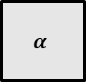
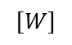
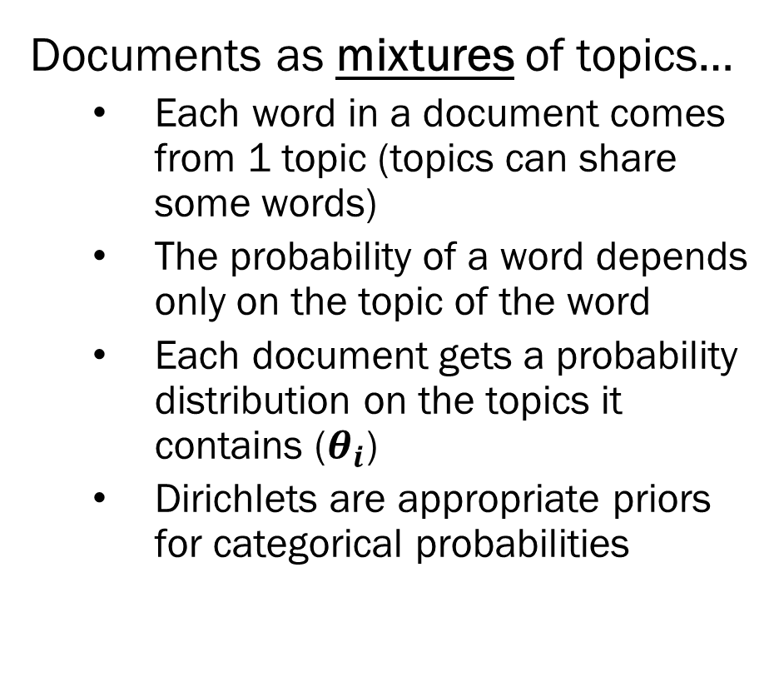
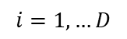
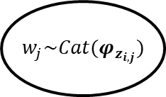
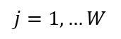
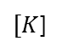
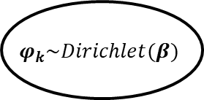
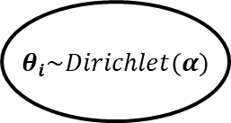
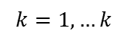
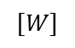
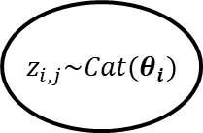

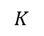
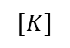
pip install pydot-ng
Latent Dirichlet Allocation
Documents as mixtures of topics…
Each word in a document comes from 1 topic (topics can share some words)
The probability of a word depends only on the topic of the word
Each document gets a probability distribution on the topics it contains ($θ_{i}$)
Dirichlets are appropriate priors for categorical probabilities
$$α$$
$$β$$
$$φ_{k}\sim Dirichlet(β)$$
$$[K]$$
$$[W]$$
$$[W]$$
(Topics)
$$k=1, …k$$
$θ_{i}\sim Dirichlet(α)$
$z_{i,j}\sim Cat(θ_{i})$
$w_{j}\sim Cat(φ_{z_{i,j}})$
$[K$]
$$K$$
(Words within a Document)
$$j=1, …W$$
(Documents)
$$i=1, …D$$

Slide 13

pip install pydot-ng
Why Graphs?
Graphical Representations are useful for:
Checking for circular dependencies
Cycles – Not improper, just very difficult to estimate
Getting the “structure” of the model
Useful for getting a high level sense of what the model does
Checking for computational choke points
E.g. Categorical switches mean you have to iterate over all possible categories…
Bayesian Networks (or Belief Networks)
Simplified Graphical Representations
Just defines conditional dependencies…
i.e. you still have to eventually assign probability distributions…
A
B
C
$$P\left(A, B, C\right)=P\left(A | C\right)P\left(B | A\right)P(C|B)$$

Slide 14
pip install pydot-ng
Probabilistic Programming
We could implement any Bayesian model we wanted using scikit-learn, numpy and pandas. However, we’d have to figure out all the estimation methods…
Enter probabilistic programming languages!
Stan – One of the original and best maintained, works well for smaller data
PyMC3 – Built for data science, plenty of powerful estimation techniques!
We’ll be using PyMC3 for the rest of the course!

Slide 15
pip install pydot-ng
First Steps in PyMC3
WARNING: Installing PyMC3 is tricky due to its dependencies. Follow the directions exactly (from here)
PyMC3 has 3 major components
The Model class – Where we put our model definitions
The random variables – How we define our models
Estimation techniques – The behind the scenes magic
import arviz as az
import matplotlib.pyplot as plt
import numpy as np
import pymc3 as pm
import theano.tensor as tt
with pm.Model() as model:
#We define our model here

Slide 16





pip install pydot-ng
Normal with Known Variance – PyMC3
$$μ_{0}$$
$$σ_{0}^{2}$$
import arviz as az
import matplotlib.pyplot as plt
import numpy as np
import pymc3 as pm
import theano.tensor as tt
with pm.Model() as model:
prior_mu = pm.Normal(“mu”, mu = 0, sigma = 1)
obs_x = pm.Normal(“obs_x”, mu = prior_mu, sigma = 1, observed = np.random.randn(100))
idata = pm.sample(draws = 2000, tune = 1500, return_inference = True)
$$μ\sim N(μ_{0}, σ_{0}^{2})$$
$$c$$
$$X_{i}\sim N(μ, c)$$
$$i=1, …n$$
Notes –
All random variables are treated the same. Priors just don’t have variables for parameters
pm.sample - This line actually runs the model, but you can specify without it.

Slide 17






pip install pydot-ng
Normal with Unknown Variance – PyMC3
import arviz as az
import matplotlib.pyplot as plt
import numpy as np
import pymc3 as pm
import theano.tensor as tt
V = 10
dat = np.random.randn(100) + 5
with pm.Model() as model:
prior_sigma = pm.InverseGamma(“sigma”, alpha = 1, beta = 1)
prior_mu = pm.Normal(“mu”, mu = 0, sigma = prior_sigma/V)
obs_x = pm.Normal(“obs_x”, mu = prior_mu, sigma = prior_sigma, observed = dat)
idata = pm.sample(draws = 2000, tune = 1500, return_inferencedata = True)
$$μ_{0}$$
$$v$$
$$α$$
$$β$$
$$μ\sim N(μ_{0},\frac{σ^{2}}{v})$$
$$σ^{2}\sim InvGamma(α,β)$$
$$X_{i}\sim N(μ, σ^{2})$$
$$i=1, …n$$

Slide 18

pip install pydot-ng
Normal with Unknown Variance – PyMC3

Slide 19







pip install pydot-ng
Normal with Unknown Variance – PyMC3
Probabilistic Programming languages are useful
because we can move away from conjugate priors!
import arviz as az
import matplotlib.pyplot as plt
import numpy as np
import pymc3 as pm
import theano.tensor as tt
V = 10
dat = np.random.randn(100) + 5
with pm.Model() as model:
prior_sigma = pm.HalfCauchy(“sigma”, beta = 1000)
prior_mu = pm.Normal(“mu”, mu = 0, sigma = prior_sigma/V)
obs_x = pm.Normal(“obs_x”, mu = prior_mu, sigma = prior_sigma, observed = dat)
idata = pm.sample(draws = 2000, tune = 1500, return_inferencedata = True)
$$μ_{0}$$
$$v$$
$$α$$
$$β$$
$$μ\sim N(μ_{0},\frac{σ^{2}}{v})$$
$$σ^{2}\sim HalfCauchy(β)$$
$$X_{i}\sim N(μ, σ^{2})$$
$$i=1, …n$$

Slide 20

pip install pydot-ng
Normal with Unknown Variance – PyMC3

Slide 21





Bayesian Regression
import arviz as az
import matplotlib.pyplot as plt
import numpy as np
import pymc3 as pm
import theano.tensor as tt
V = 1
dat_X = np.reshape(np.random.randn(1000), (100,10))
true_beta = np.arange(10)+1
y = np.matmul(dat_X, true_beta) + np.random.randn(100)*np.sqrt(.5)
with pm.Model() as model:
error_dist =pm.HalfCauchy('error', beta = 1000)
prior_sigma_chol, corr, sigma = pm.LKJCholeskyCov('sigma’,
eta = 1, sd_dist = pm.Exponential.dist(1), n = 10, compute_corr= True)
prior_beta = pm.MvNormal('mu', mu = np.repeat(0,10), chol = prior_sigma_chol, shape = 10)
t.printing.Print(pm.math.dot(dat_X, prior_beta))
obs_x = pm.Normal('obs_y', mu = pm.math.dot(dat_X, prior_beta), sigma = error_dist, observed = y)
idata = pm.sample(draws = 2000, tune = 1500, return_inferencedata = True)
$$μ_{0}$$
$$η$$
$β\sim MVN(μ_{0},Σ_{0})$
$$Σ_{0}^{2}\sim LKJCholesky(η)$$
$$β$$
$$Y_{i}\sim N(βX_{i}, ε^{2})$$
$$ε^{2}\sim HalfCauchy(β)$$
$$i=1, …n$$
Note that LKJ Cholesky refers to a distribution over covariance matrices ($η=1$ causes that distribution to be uniform.)

Slide 22



Bayesian Regression
These are exactly the $β$ values I want to see.
$\sqrt{.5}=.707$, which is the error variance I want.
Spike at 0 means that a degree of sparsity was enforced on $Σ$
Yes, this makes sense. Larger $β$s have larger variances.
All correlations between $β$s were close to 0…

Slide 23
Summary + Next Steps
There it is… that’s the course… You can put together any model:
First draw it out as a graph of conceptual dependencies,
Assign distributions and functional relations
Write it up in PyMC3
Honestly, you don’t even need to be that knowledgeable about statistical theory… Bayesian estimators just work.
Well…
If the model is intelligible (I do also mean identifiable, it’s quite hard to tell sometimes)
If the model is parameterized well (the forbidden art of matrix factorization is a strength here…)
If the priors are specified well (oh yes, we will use priors to stabilize estimation)
If the estimator is chosen correctly (at least half the fun)
If math lets you (I hope you know a lot about machine precision and floating point numbers, you’ll need it!)

Slide 24

Next Steps
Estimators – First you crawl, then you walk, then you gradient descend.
Week 5 – Samplers, a Bayes’ first estimator
Gibbs sampling – For when you are very lucky and have conditionally proper posteriors
Metropolis/Metropolis-Hastings – Guaranteed to get you a posterior (as $t→∞$)
Week 6 – Sampling from categorical distributions
It is by far the trickest issue I’ve encountered.
The phrase “combinatoric nightmare” comes to mind
Week 7 – Bayesian Model Averaging
Instead of 1 model… why not just fit all of them?
This is a big space for data science, it benefits from large scale parallel computation
Beyond – Cheating math with variational estimators, mixing it up with mixture models and more…

Slide 25









Dirichlet Mixture Model
Documents have 1 topic
The probability of a word depends only on the topic of the document
Appropriate for short texts or documents meant to have 1 main topic (news articles?)
What are the inferential differences between DMMs and LDirA?
$$α$$
$$β$$
$$φ_{k}\sim Dirichlet(β)$$
$$[K]$$
$$[W]$$
$$[W]$$
(Topics)
$$k=1, …,K$$
$θ\sim Dirichlet(α)$
$z_{j}\sim Cat(θ)$
$w_{j}\sim MuNom(φ_{z_{i}})$
$[K$]
$$K$$
(Documents)
$$j=1, …D$$

